Slide 1
Blockchain Economics
Markets
Web3 Development for Beginners

Slide 2
Why markets matter in web3?
Web3 deals a lot with assets
Assets are traded

Slide 3
Supply & Demand
Now what?
We have a market for supply to meet demand

Slide 4
Physical Markets
Fleemarkets
Supermarkets
Historic Stock Markets
etc

Slide 5
Online Markets
Ebay
Amazon
Stock Markets
Crypto Markets

Slide 6
How does a market work?
Facilitate transaction when: offered price >= asking price
Hold “orders” until they are met

Slide 7
Orderbook
List of all asking prices
List of all offering prices

Slide 8
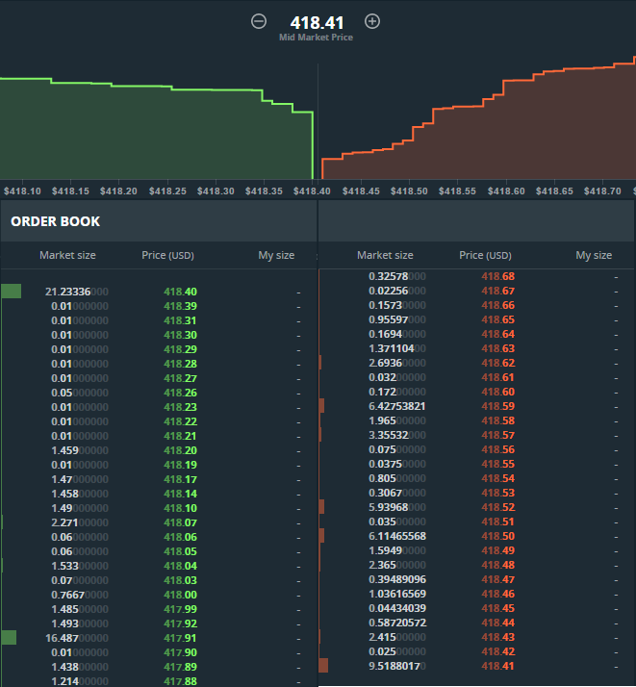

Slide 9
Centralized Exchanges
Facilitate order matching (matchmakers)
Charge fees
Transaction fee
Payment-For-Order-Flow
Arbitrage

Slide 10
Recap
Markets facilitate transactions
Supply & Demand determine price

